Slide 1
What is S&P 500 index?
- an overview of the most followed equity index

Slide 2
Overview
Who is the audience
People who have limited knowledge in finance
Why do I care?
one of the most commonly followed and cited equity indices, and many considered it a bellwether or the U.S. economy
it is a reflection of the composition of the economy (It’s old but its components change over time)
Boring?? but most hedge funds in the last few years cannot beat the benchmark index (passive investment vs active investment)
What’s S&P
an American stock market index
based on the market capitalizations of 500 large companies having common stock listed on the NYSE or NASDAQ.
it's market-weighted
S&P 500 was founded in 1957, and it gave rise to indexing
500 stocks but it comprised of 80% of the market
Overview
What’s in the index
Market Capitalization by Sector
Fundamental Ratio by Sector
52 Weeks High, Price Range, and Company Size
What's Next

Slide 3
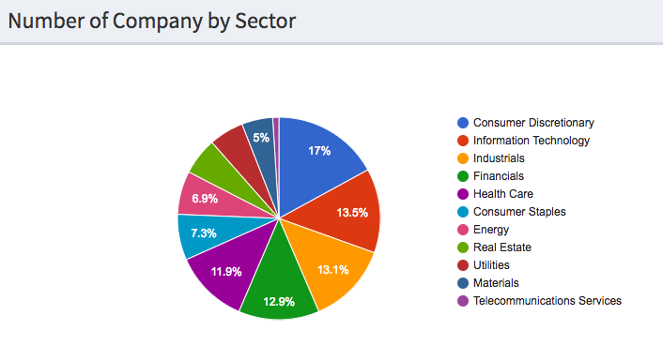
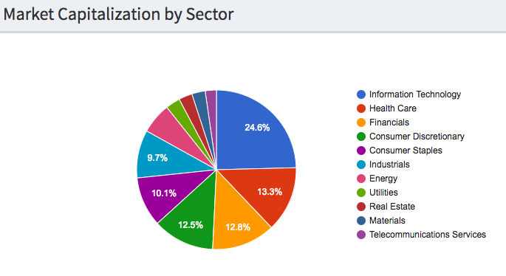
What’s in the index
SP500 is very diverse - has 11 major sectors
Consumer Discretionary is the most popular sector
Information Technology is the biggest sector by market capitalization.
the top 3 sectors in the index (Information Technology, Health Care and Financials) comprised of more than 50% of the index
Overview
What’s in the index
Market Capitalization by Sector
Fundamental Ratio by Sector
52 Weeks High, Price Range, and Company Size
What's Next

Slide 4
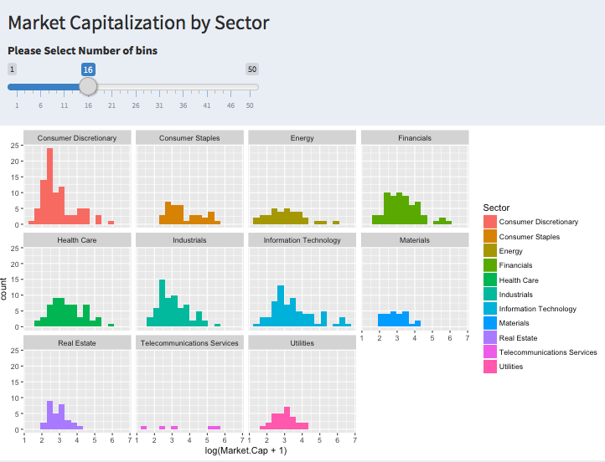
Market Capitalization by Sector
company’s market capitalization is not normally distributed (even after log transformation)
Movement of big companies has a greater impact on the index
Example of outliers:
Information Technology (Apple, Alphabet, Microsoft, Facebook)
Consumer Discretionary (Amazon)
Energy (Exxon Mobil)
Health Care (Johnson & Johnson)
Financial (JP Morgan, Wells Fargo, Bank of America)
Overview
What’s in the index
Market Capitalization by Sector
Fundamental Ratio by Sector
52 Weeks High, Price Range, and Company Size
What's Next

Slide 5
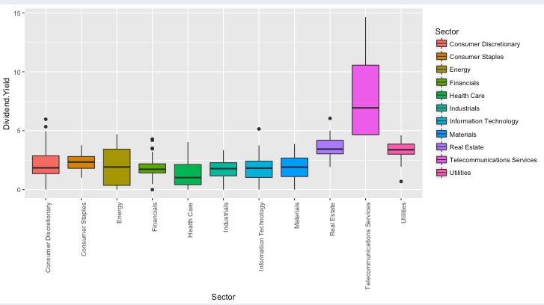
Fundamental Ratio by Sector (I) (Dividend Yield)
As expected, Telecommunication Services, Utilities and Real Estate have the higher dividend yield
Overview
What’s in the index
Market Capitalization by Sector
Fundamental Ratio by Sector
52 Weeks High, Price Range, and Company Size
What's Next

Slide 6
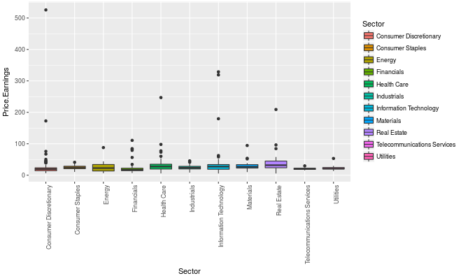
Fundamental Ratio by Sector (II) (Price per Earning)
High P/E = expensive stock?
(investors overpaid per earning dollar?)
High P/E = hot stock?
(investors are willing to overpay per current earning dollars for its growth potential)
Examples:
Consumer Discretionary:
Chipotle ( P/E @525)
Amazon (P/E @ 173)
Information Technology
Netflix (P/E @ 329)
Overview
What’s in the index
Market Capitalization by Sector
Fundamental Ratio by Sector
52 Weeks High, Price Range, and Company Size
What's Next

Slide 7
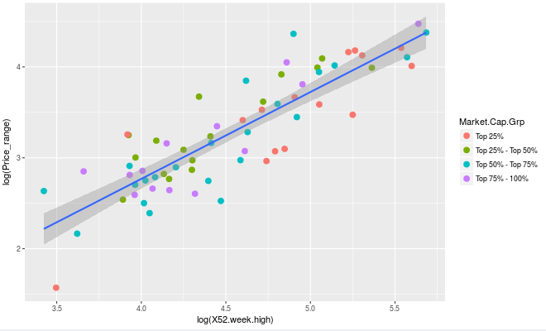
52 Weeks High, Price Range & Company Size
Linear Relationship between 52 weeks high and Price Range (consistent among all industries)
big companies have high stock price
Price clusters in different industries is not so obvious
Overview
What’s in the index
Market Capitalization by Sector
Fundamental Ratio by Sector
52 Weeks High, Price Range, and Company Size
What's Next

Slide 8
What’s Next?
Summary
S&P500 has a diverse sector distribution
Dynamic nature of the index, it reflect the current state of the economy
Some statistics reflects “hotness” factor? and it is relevant to us!!!
How can I improve this project?
Improve graph (more interactive)
Adjust format and color
Incorporate time dimension
Any Questions and comments?
Overview
What’s in the index
Market Capitalization by Sector
Fundamental Ratio by Sector
52 Weeks High, Price Range, and Company Size
What's Next

